Slide 1
Modern Processes w/ Power Automate
Charles @ The II Lakes Group
Notes:
Welcome.
Disclaimer, this session is ideal for beginner and intermediate level people, but advanced people can follow along.

Slide 2






Platinum Sponsors
Speaker Dinner Sponsor
Gold Sponsors
Notes:
Thank you to our sponsors.
Without them, our organizers wouldn’t be able to put these events on.

Slide 3
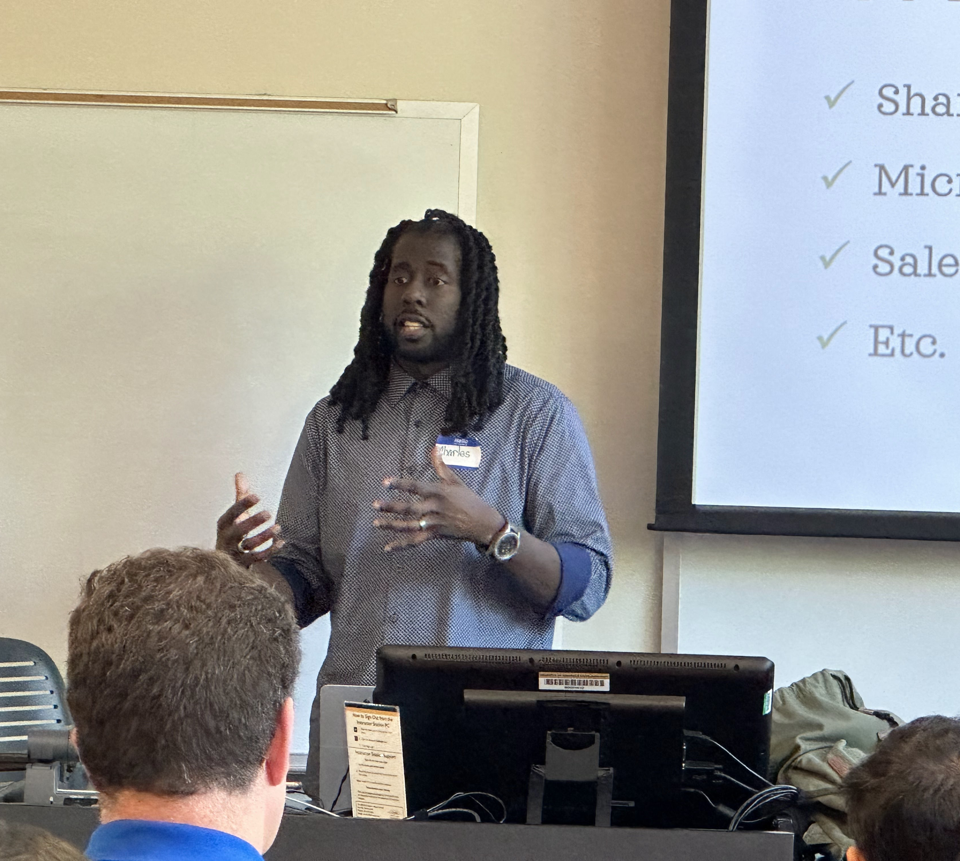
About Me
Programmer
Blogger
Speaker
Traveler
Middle-child

Slide 4
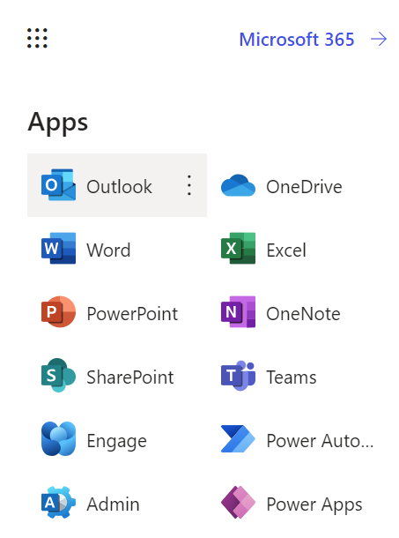
Agenda
Understanding automation
What are Triggers?
What are Actions?
Understanding low-code
What are Variables?
What are Expressions?
What are Connectors?
Notes:
Who has heard of “low-code” before this event?
Who has worked with “low-code” before this event?
Who has worked with Power Automate specifically?
There are desktop and cloud flows, but today we’re focusing on cloud. Why? No installation required.

Slide 5
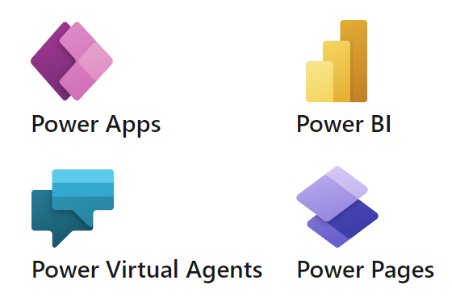

But first…
Why the Power Platform?
High developer demand.
Democratize technology.
Quicker ROI.
Modernize solutions.
Notes:
More traditional companies are being tech companies. E.g., Banking, Healthcare. Not enough traditional developers or coders to meet the demand.
Everyone should be able to build.
Companies can try out the tools without a huge initial investment and do a lot. Bring some third-party solutions in-house.
Legacy solutions, like VBA, are slowing dying as Microsoft discourages it now. People were and still are developing solutions w/ VBA.

Slide 6
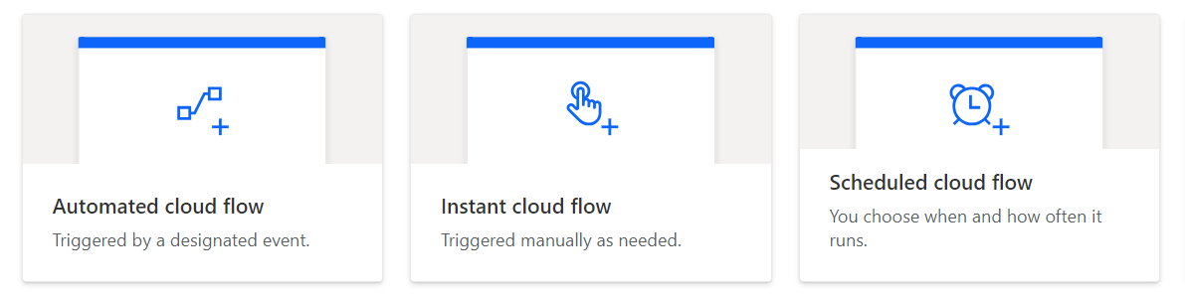



Understanding automation
What are Triggers?
Notes:
Before building an automation, consider: What is the process and what is it doing?
Automations are repeatable processes. Triggers are the process kick-offs. What gives the process the “go-ahead”? The jumping off point?
E.g., received an email, saw an document was modified, pushed a button, runs every Friday @ noon.
E.g., Google contact modified,

Slide 7
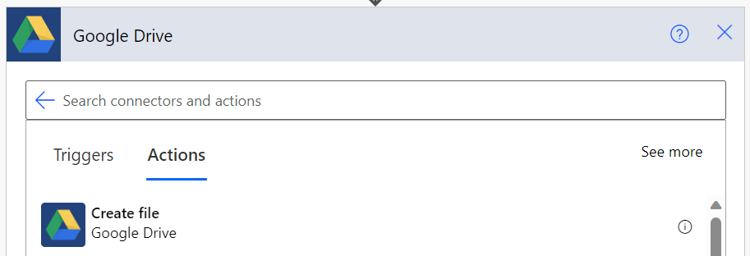
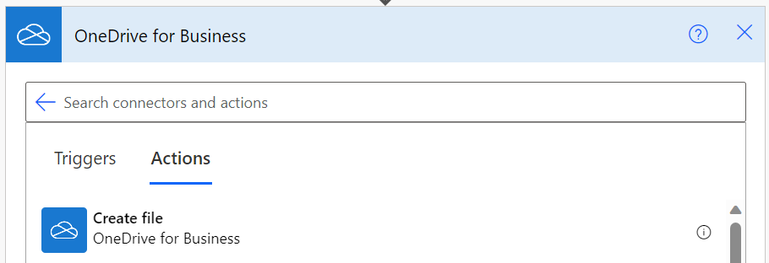
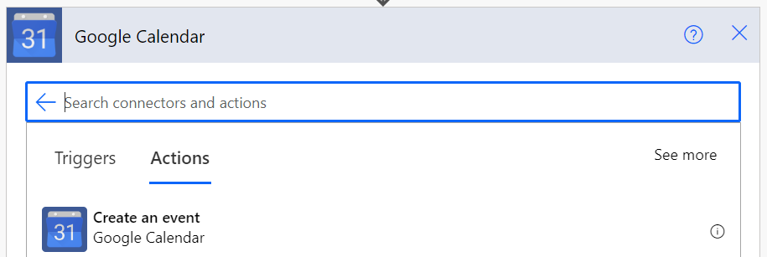
Understanding automation
What are Actions?
Notes:
What is the process doing? These are the steps in an automation.
E.g., Create an item, share a file, upload a document, notify a person, approve a request, etc.

Slide 8
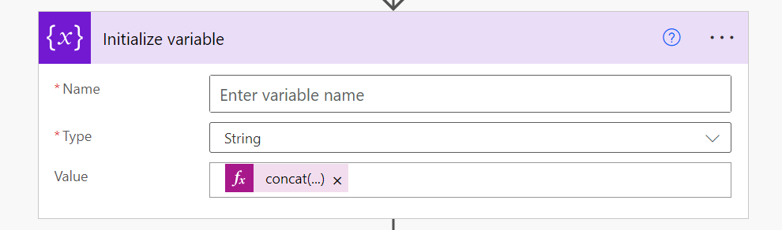
Understanding low-code
What are Variables
Notes:
Buckets to hold types of data like numbers, strings, and bools.
E.g., strings like names,
E.g., numbers like counts,
E.g., Booleans like item states (on/off).
These variables are then used in conditions.

Slide 9
Understanding low-code
What are Expressions
Notes:
Expressions are functions, like in algebra. Or like in Excel. Provide a formula name and parenthesis, with the parameters. Throw something in and get a result.
E.g., string | split()
E.g., collection | length(), sort()
E.g., math | add(), mod(),
E.g., date | utcNow(), addMinutes()

Slide 10
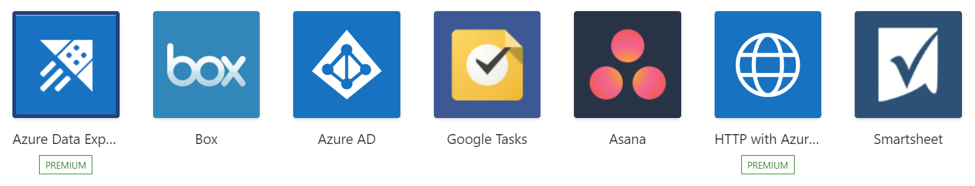
Understanding low-code
What are Connectors
Notes:
Proxies of services. You don’t have to build linkage between cloud solutions or code authentication.
NOTE: Runs under the credentials of the provided account.
Standard v Premium. Extra monthly cost premium, but standard are included in the regular license.
Not all Microsoft

Slide 11
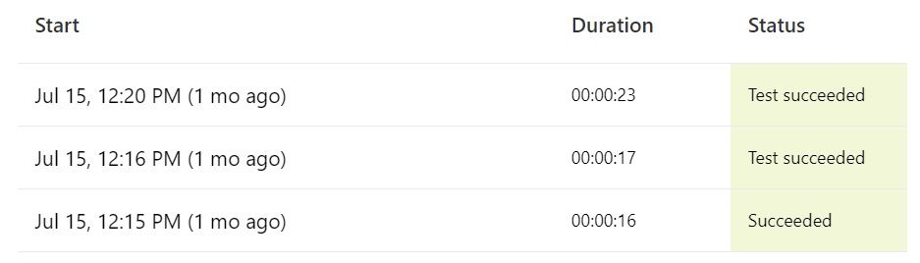
Demo
Notes:
Three ways to get started.
#1: Templates – Know what you’re looking for? Microsoft + Community provided
#2: Copilot – Don’t know what you’re looking for? Copilot + AI assisted
#3: Schedule weekly email of open Microsoft Lists items.

Slide 12
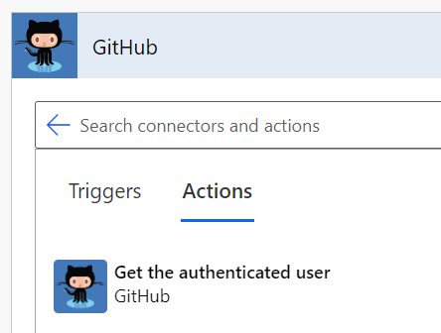
https://github.com/losodamus
Contact
Notes:
The II Lakes Group

Slide 13
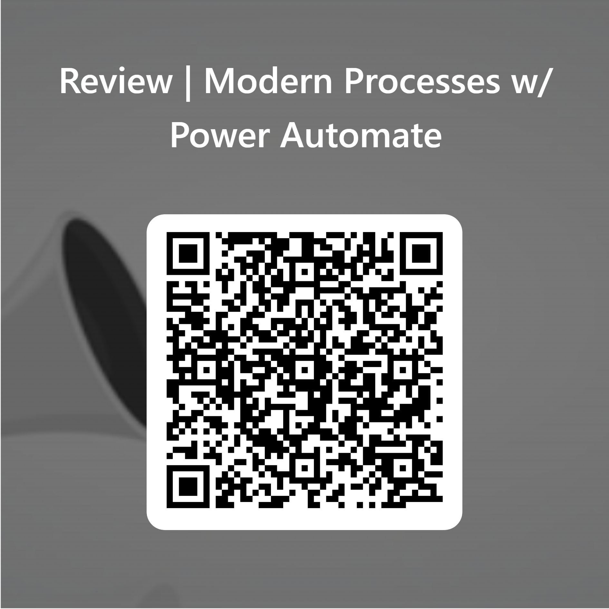
https://forms.office.com/r/NAMYGCc56E
Grazie!

